Slide 1
Lean Six Sigma Project on Reducing Defects in Ampoules at Mercury Laboratories Ltd.
Guided by- Prof. K. MURALIDHARAN
Miss AKRUTI SHUKLA
Presented by:
Ira Chakraborty
Vernal Damor
Brijesh Dubey
Kunj Panchal

Slide 2
Company Profile
Founded in 1962, with the vision to be a leading manufacturer of pharmaceutical products with
  Highest ethical standard.
  Generate long lasting customer loyalty.
  Providing outstanding quality , service and customer satisfaction.
The company began producing pharmaceutical products for mother and child healthcare and subsequently introduced products in all dosage forms like tablets, capsules, liquids and injectable.
They have their reputed presence in more than 20 countries directly and in more than 15 countries indirectly, they are present in Asia, Africa and Far East countries and they will be in USA and European Countries in few years.

Slide 3
Overview of the Ampoules manufacturing process
Importing
They are imported.
Random Sampling done.
Washing
The number of Ampoules/Vials are pre-decided a day before based on solution required.
Two machines : 1) Only Ampoules 2) Both Ampoules and Vials.
DHS
Dry Heating Sterilization.
Chances of defects.
Approval by Packaging Dept. for use.
Filling
Arranged in trays after washing and sent to DHS.
Visual Inspection
Solution is filled in Ampoules/Vials.
They are sealed here.
Defects possible.
Sealed Ampoules/Vials are checked for :Black Particles, Glass, Empty or broken products
More chances of defects (5%).
Dispatch
After visual inspection, they are labelled and packed, ready for dispatch.
Labelling contains error.
0.1% breakage failure in dispatch.

Slide 4
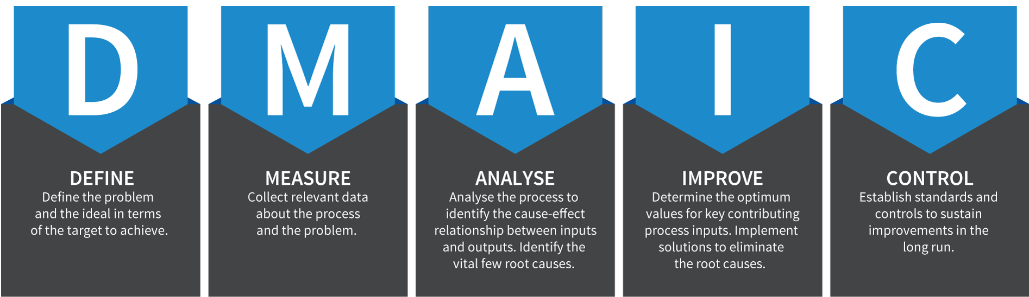
Project Roadmap

Slide 5
Define Phase Roadmap
DEFINE
PROJECT CHARTER
SIPOC
MEASURE
GANTT CHART
ANALYSE
IMPROVE
CONTROL

Slide 6
PROJECT CHARTER
Title: “Lean Six Sigma Project on Reducing Defects in Ampoules at Mercury Laboratories Ltd.”
Customer: - External: Whole Sale Customers. Internal: Quality Assurance and Inspection | Timeline: See Gantt Chart Define Measure Analyze Improve Control
Problem Statement: Low Sigma Level High Transit Time | Objective Statement: Improving Quality of entire process: In terms of cost. In terms of time. In terms of Sigma level.
Primary Concern: Reducing defects in ampoules. Improving sigma level of the process Decreasing Transit Time | Guide: Dr. Prof. K. Muralidharan Ms. Shukla Akruti Team Members: Kunj Panchal Brijesh Dubey Ira Chakraborty Vernal Damor

Slide 7
SIPOC
 | S | I | P | O | C
Process | Supplier | Input | Critical Process Steps | Output | Customer
Washing | F-Scout (Ampoule bottle manufacturing Company) | Ampoules | Loading Washing Placing in trays | Washed Ampoules | Filling Process
Filling | Washing | Washed Ampoules Solution | Loading Filling Unloading | Filled Ampoules | Cleaning
Cleaning | Filling Process | Filled Ampoules | Water Testing Cleaning of Sticky Solution Drying of Ampoules | Cleaned Ampoules | Visual Testing
Visual Testing | Cleaning | Cleaned Ampoules | Glass Testing Fiber Testing Particle Testing | Tested Ampoules | Packaging
Packaging | Tested Ampoules | Tested Ampoules | Box Making Labelling Box Filling | Packaged Ampoules | Production Unit

Slide 8
Gantt Chart
The Gantt chart is a simple horizontal Bar chart, where bars represents the actual calendar time which is planned for each task. The scale used for this will depend on the overall size of the project.
Company Name: Mercury Laboratories Limited
 | Month | December |  | January |  |  |  | February |  |  |  | March |  |  |  | April
 | Week | 3 | 4 | 1 | 2 | 3 | 4 | 1 | 2 | 3 | 4 | 1 | 2 | 3 | 4 | 1 | 2
Define | Scheduled
 | Actual
Measure | Scheduled
 | Actual
Analysis | Scheduled
 | Actual
Improvement | Scheduled
 | Actual
Control | Scheduled
 | Actual

Slide 9
Define Phase Summary:
We started by preparing the Project Charter. Gantt chart which represents the actual calendar time which is planned for each phase of DMAIC. Then we used SIPOC for better understanding of the process .

Slide 10
Measure Stage Roadmap
DEFINE
MEASURE
ANALYSE
IMPROVE
CONTROL
Data Collection
Process Sigma Level

Slide 11
DATA COLLECTION SHEET
Our main purpose to collect the data was to find out the defects in each process of ampoules starting from washing upto packaging.
We started collecting our data from 22nd December 2016.

Slide 12
Initial Process Sigma Level

Slide 13
ANALYSIS PHASE ROADMAP
DEFINE
MEASURE
ANALYSE
IMPROVE
CONTROL
FMEA
Cause and Effect Diagram
Pareto chart
5S Methodology

Slide 14
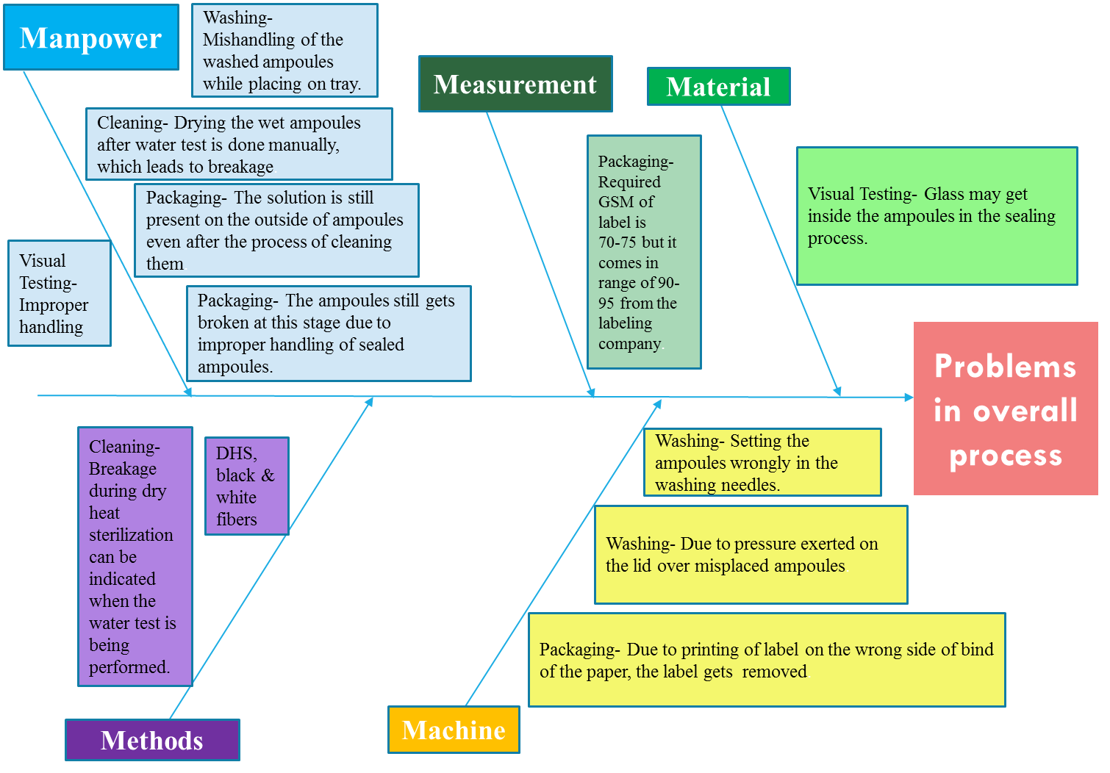
Cause and Effect Diagram

Slide 15
Causes of Defects in each process:
1. Washing Process
Cause of defects |  | Machine 1 | Machine 2
1.While loading: | Setting the ampoules wrongly in the washing needles. | 50% | 40%
2.While Washing | Due to manual pressure exerted on the lid over misplaced ampoules. | 0% | 37%
3.While placing Ampoules in tray: | Mishandling of the washed ampoules while placing on tray. | 50% | 23%

Slide 16
2. Cleaning Process
Causes of Defects |  | %
Defects while performing water test: | Breakage during dry heat sterilization can be indicated when the water test is being performed. | 63
Other reasons | Drying the wet ampoules after water test is done manually, which leads to breakage. | 37

Slide 17
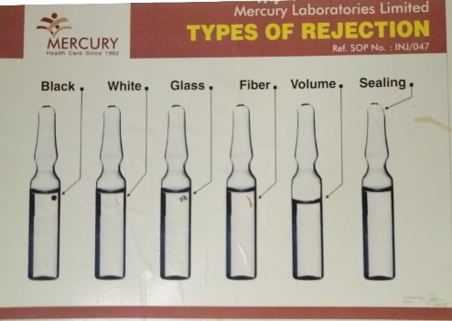
3. Visual Inspection Process
The ampoules are checked for the following defects:
  Black particle
  White particle
  Glass particle
  Fiber
  Volume
  Sealing
  Breakage
They are considering Black & White Fiber particles as one defect namely Fiber.
They are considering Sealing and Breakage as Breakage Defect

Slide 18
Causes of defects (Visual Inspection) |  | %
Breakage | The breakage in the ampoules can be found due to mishandling in the drying process or due to mishandling while carrying it to the visual testing unit. | 50
Glass | Glass may get inside the ampoules in the sealing process. | 32
Fibers | Dry heat sterilization process may leave black or while fibers inside the ampoules which may be detected in visual testing process. | 18

Slide 19
4. Packaging Process
Reasons | Causes | %
GSM of labels more than required. | Required GSM of label is 70-75 but it comes in range of 90-95 from the labeling company. | 30%
Wrong side printing on label. | Due to printing of label on the wrong side of bind of the paper, the label gets less removed.
Solution on outside | The solution is still present on the outside of ampoules even after the process of cleaning them.
Breakage | The ampoules still gets broken at this stage due to wear and tear of all the processes. | 70%

Slide 20
FMEA (Failure Mode Effect Analysis)
Failure modes and effects analysis (FMEA) is a set of guidelines, a process, and a form of identifying and prioritizing potential failures and problems in order to facilitate process improvement.
Severity: Assesses the seriousness of the effect of the potential failure mode to the next component if it occur. Estimation is typically based on a 1–10 scale where 10 is the most serious, 5 is low, and 0 is no effect.
Occurrence: Estimates the likelihood that a specific cause will occur. Estimation is usually based on a 1–10 scale where 10 is very high, 5 is low, and 1 is remote.
Detection: Assessment of the ability of the current design control to detect the subsequent failure mode. Assessment is based on a 1–10 scale where 10 is absolute uncertainty, 5 is moderate, 1 is almost certain.
Risk priority number (RPN): Product of severity, occurrence, and detection rankings. The ranking of RPN prioritizes design concerns.

Slide 21
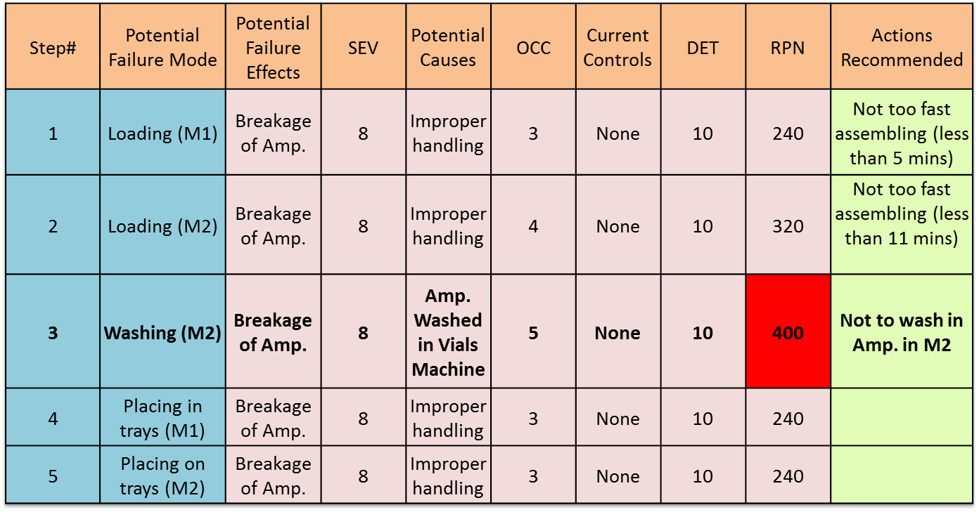
FMEA FOR WASHING
Interpretation: We can observe from above table that RPN is highest for breakage of ampoules in machine 2. Hence it should be revised and try to reduce it.

Slide 22
Potential failure Mode | Recommendations | Reason
Loading M1 | Not too fast assembling (time taken should be more than 5 mins) | From the Pie chart for M1 given below we see that if the time taken to load the machine is greater than 5 mins, it amounts to less number of defectives .
Loading M2 | Not too fast assembling (time taken should be more than 11 mins) | From the Pie chart for M2 given below we see that if the time taken to load the machine is greater than 12 mins, it amounts to less number of defectives .
Washing | Not to wash in Ampoules in M2

Slide 23
Chi Square Test For Association (M1)
H0: | There is no association between defectives and time <5 minutes
H1: | There is association between defectives and time <5 minutes
time taken | Breakage | non defective | Total | Chi-Sq | 3 |  | Breakage Expected | non defective Expected
<5minutes | 15 | 9 | 24 | p | 0.083265 |  | 12 | 12
>5minutes | 9 | 15 | 24 | a | 0.05 |  | 12 | 12
Total | 24 | 24 | 48 | Variables are Independent
 | Breakage | non defective | Contribution
<5minutes | 0.75 | 0.75
>5minutes | 0.75 | 0.75
CONCLUSION: | Here as p value > 0.05 hence, we do not reject our null hypothesis
 | therefore we can say that there is no association between defectives and time < 5minutes

Slide 24
Chi Square Test For Association (M2)
H0: | There is no association between defectives and time <11 minutes
H1: | There is association between defectives and time <11minutes
time taken | Breakage | non defective | Total | Chi-Sq | 45.09090909 |  | Breakage Expected | non defective Expected
<11minutes | 56 | 43 | 99 | p | 0.00000000016167 |  | 66 | 33
>11minutes | 43 | 56 | 99 | a | 0.05 |  | 66 | 33
 | 99 |  | 99 | Variables are Related |  |  | 66 | 33
Total | 198 | 99 | 297
 | Breakage | non defective | Contribution
<11minutes | 1.515152 | 3.03030303
>11minutes | 8.015152 | 16.03030303
0 | 16.5 | 33
CONCLUSION: | Here as p value < 0.05 hence,we reject our null hypothesis
 | therefore we can say that there is association between defectives and time < 11minutes

Slide 25
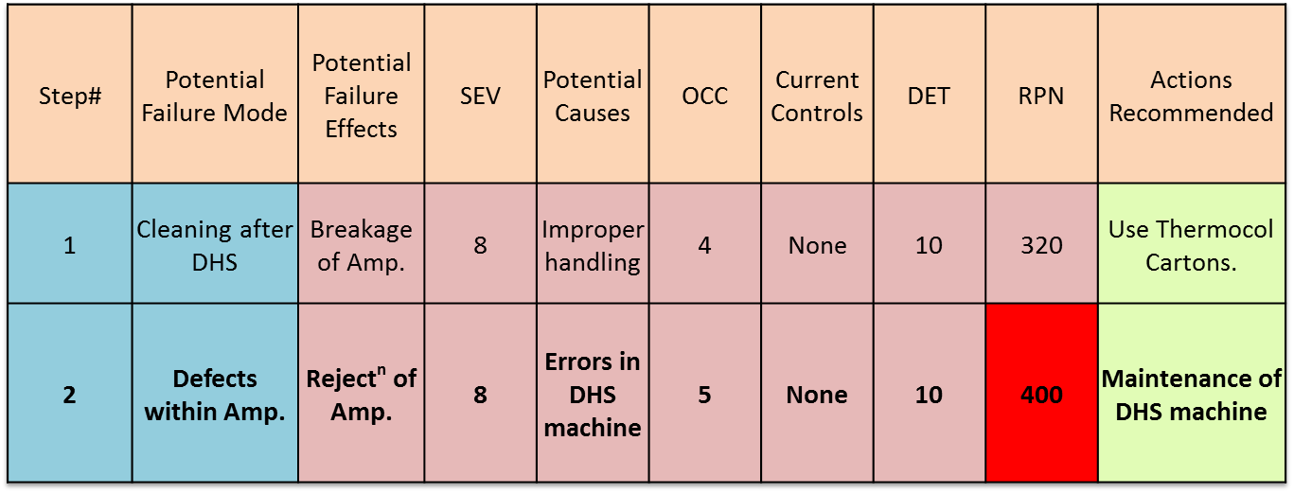
FMEA FOR VISUAL INSPECTION
Interpretation: We can observe from above table that RPN is highest for rejection of ampoules due to defects within ampoules. Hence it should be revised and reduced.

Slide 26
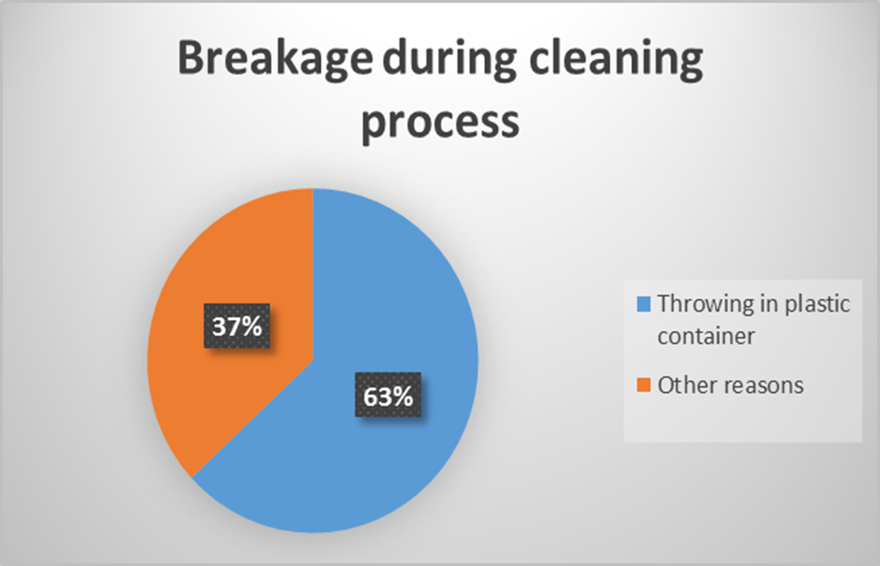
Potential failure Mode | Recommendations | Reason
Cleaning after DHS | Use Thermocol Cartons | From the Pie chart given below we see that the breakage due to Throwing the ampoules in plastic containers amounts to more percentage of defectives while cleaning Ampoules than that of other reasons.
Defects within Ampoules | Maintenance of DHS machine | Defects within ampoules, presence of glass and fibers can be reduced only by maintenance of the DHS machine.

Slide 27
Chi Square Test For Association (Cleaning)
H0: | There is no association between defectives and throwing in plastic container
H1: | There is association between defectives and throwing in plastic container
Breakage | Total defects | nondefective | Total | Chi-Sq | 69.71857923 |  | Total defects Expected | nondefective Expected
Throwing in plastic container | 77 | 45 | 122 | p | 0.0000000000000007258 |  | 81.33333 | 40.66667
Other reasons | 45 | 77 | 122 | a | 0.05 |  | 81.33333 | 40.66667
 | 122 |  | 122 | Variables are Related |  |  | 81.33333 | 40.66667
Total | 244 | 122 | 366
 | Total defects | nondefective | Contribution
Throwing in plastic container | 0.230874 | 0.461749
Other reasons | 16.23087 | 32.46175
0 | 20.33333 | 40.66667
CONCLUSION: | Here as p value < 0.05 hence,we reject our null hypothesis
 | therefore we can say that there is association between defectives and throwing in plastic container

Slide 28
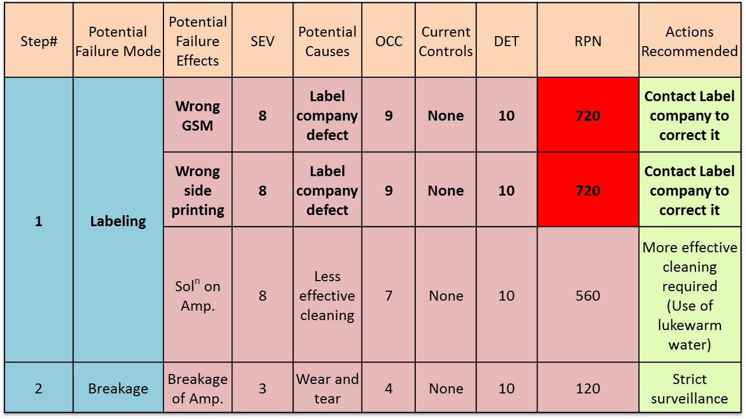
FMEA for PACKAGING
Interpretation: We can observe from above table that RPN is highest for wrong side printing and solution left on ampoules during labelling. Hence it should be revised and reduced.

Slide 29
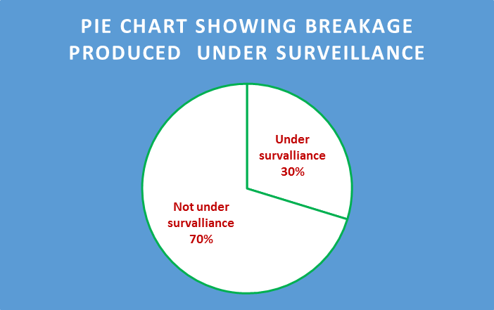
Potential failure Mode | Recommendations | Reason
Wrong GSM | Contact Label company to correct it | Since labels are not manufactured in Mercury Laboratories
Wrong side printing | Contact Label company to correct it | Since labels are not manufactured in Mercury Laboratories
Solution on Amp. | More effective cleaning required (Use of lukewarm water) | Cost effective solution to this problem
Breakage of Amp. | Strict surveillance | The pie Chart below shows the percentage of breakage under surveillance is more than when the process is not under surveillance.

Slide 30
Chi Square Test For Association For Packaging
H0: | There is no association between defectives and under survalliance
H1: | There is association between defectives and under survalliance
Breakage | Total defects | non defective | Total | Chi-Sq | 12.16216 |  | Total defects Expected | non defective Expected
Under survalliance | 11 | 26 | 37 | p | 0.000488 |  | 18.5 | 18.5
Not under survalliance | 26 | 11 | 37 | a | 0.05 |  | 18.5 | 18.5
Total | 37 | 37 | 74 | Variables are Related
 | Total defects | non defective | Contribution
Under survalliance | 3.040540541 | 3.040541
Not under survalliance | 3.040540541 | 3.040541
CONCLUSION: | Here as p value < 0.05 hence,we reject our null hypothesis
 | therefore we can say that there is association between defectives and under survalliance

Slide 31
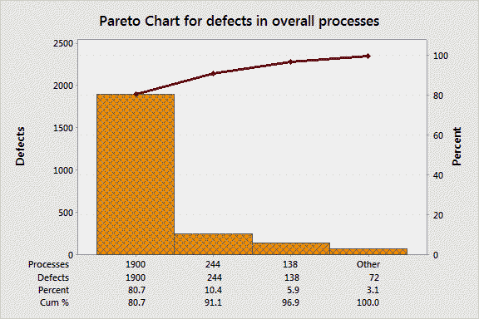
Pareto Chart
Process | Total defects(out of 10000)
Washing (Machine 1) | 19
Washing (Machine 2) | 138
Cleaning | 244
Visual Testing | 1900
Packaging | 53
Interpretation:
From this chart we can see that the Bar chart is the frequency of defects in descending order. Whereas the line chart is the % cumulative frequency of the defects in ascending order. We can observe that the maximum defect comes from Visual Inspection.

Slide 32
5S Methodology
SEIRI (Structurize)
The washing room is not well structured. The time taken to set ampoules in Machine 2 is 7 mins (on an average) more
than that of Machine 1.
The belt used in the process of packaging is old and worn out (been in use for more than 29 years).
SEITON (Systemize)
The ampoules in Machine 1 are not set systematically (upside down) leading to loss of 2 mins (on an average) on every set of 500 Ampoules.
The process of cleaning and drying is done manually this leads to breakage of Ampoules. A systematic procedure might reduce the number of breakage.
SEISO (Sanitize)
The water in cleaning process should be changed after 24 batches i.e. 2 hours.
The room for washing should be swept every 2 hours to avoid wet floors.
SEITKESU (Standardize)
Standardize procedure should be used for cleaning procedure.
SHITSUKE (Self-discipline)
The recess hours are 12 to 12:30 and 2:30 to 2:40, we observed that the workers their work 5 – 10 minutes late. Hence self-discipline should be enforced.

Slide 33
Improvement Phase Roadmap
DEFINE
MEASURE
ANALYSE
IMPROVE
CONTROL
Process Sigma Level
Improvements

Slide 34
Final Sigma Level
In Washing process, Ampoules were placed slowly and the no. of defects were noted.
In Packaging process, the labeling process was done under surveillance and the defects were noted.
In Visual Inspection, the improvements were not possible from our end.
Thus it can be seen that the sigma levels have increased in both the processes.
Washing – Machine 1 = Increment of 0.17
Washing – Machine 2 = Increment of 0.24
Packaging = Increment of 0.21

Slide 35
Cleaning process
Total no. of Units checked | 5000
No. of defects | 64
DPU | 0.0128
DPMO | 6400
Sigma level (long term) | 2.49
Sigma level (short term) | 3.99

Slide 36
Sigma Level
Process | Sigma level (Before) | Sigma Level (After)
Washing (M1) | 3.22 | 3.39
Washing (M2) | 2.61 | 2.85
Cleaning | 2.25 | 2.49
Packaging | 2.79 | 3.00

Slide 37
Control Phase Roadmap
DEFINE
MEASURE
ANALYSE
IMPROVE
CONTROL
Control Charts
Suggestions

Slide 38
Control Chart
np CHART
the np-chart is a type of control chart used to monitor the number of nonconforming units in a sample.
This assumption is the basis for the calculating the upper and lower control limits. The control limits are calculated as:
LCL = np –3 np (1 – p)
UCL= np + 3 np(1 – p)
where n is the number of items and p is the proportion of defective items. Also, zero serves as a lower bound on the LCL value.

Slide 39
Interpretation: The process is going out of Control Limits

Slide 40
Interpretation: The process is going out of Control Limits

Slide 41
Interpretation: The process is going out of Control Limits

Slide 42
Interpretation: The process is going out of Control Limits

Slide 43
After improvements:
Interpretation: The process is in Control Limits after the improvements.

Slide 44
After improvements:
Interpretation: The process is in Control Limits after the improvements.

Slide 45
After improvements:
Interpretation: The process is in Control Limits after the improvements.

Slide 46
Suggestions
In the Washing process, the Machine for vials should not be used to wash Ampoules, if possible.
New machinery should be brought, in order to reduce defects in Visual Inspection process.
In Cleaning process, there should be a change in the method where the Ampoules are cleaned manually.
For Packaging process, the label company should be contacted and the problems should be mentioned to them. Further the conveyer belt in the labeling process should be replaced. If possible, the automatic Labeling machine should be taken into use.

Slide 47
References
Six Sigma for Organizational Excellence - A Statistical Approach,
Prof. K. Muralidharan
2. Minitab 17 – Statistical Software
Quality Companion 3
www.iSixSigma.com

Slide 48
Thank you

